Slide 1
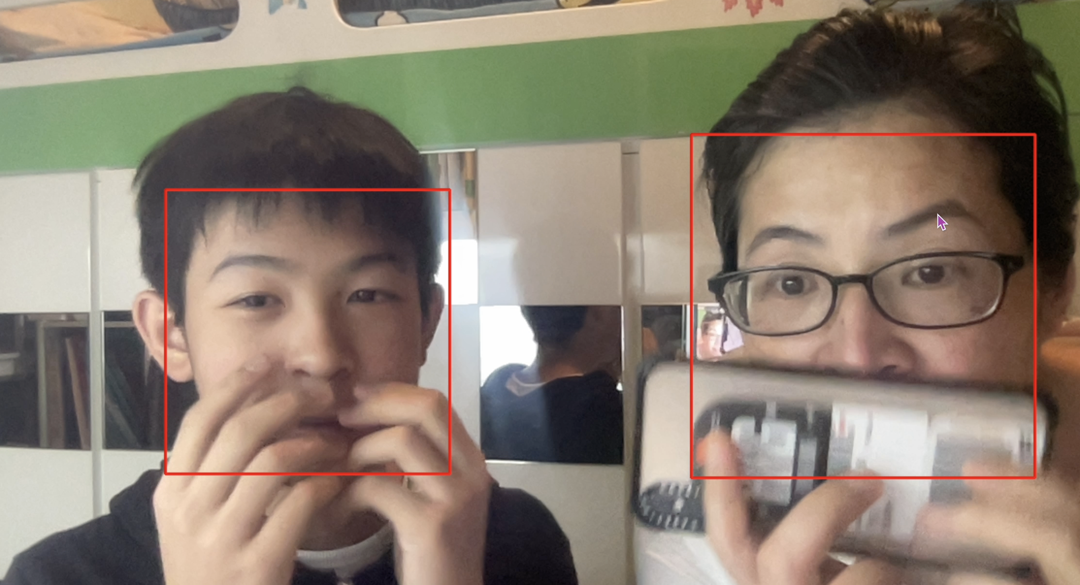
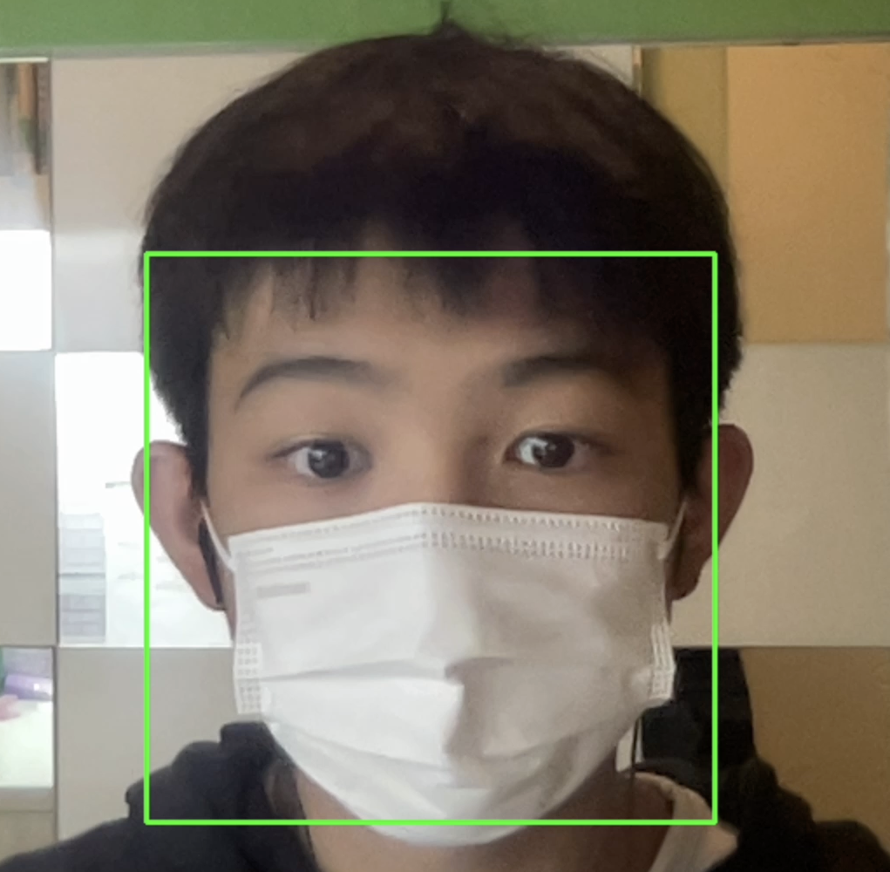
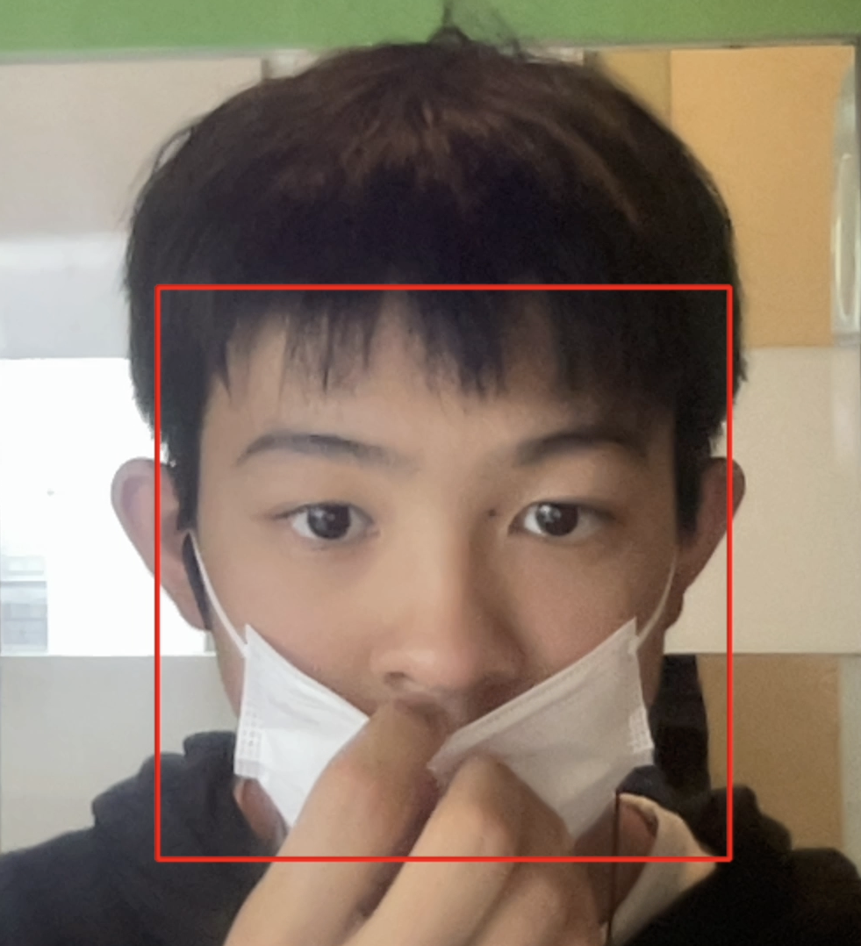
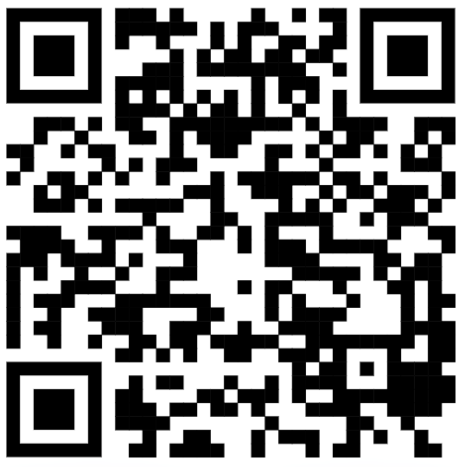
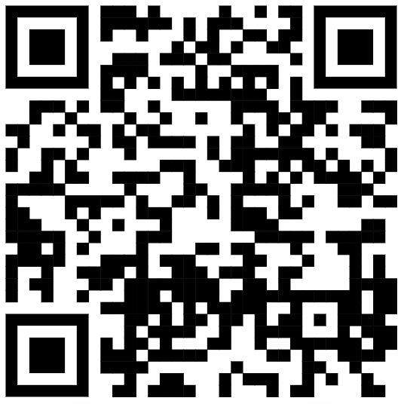
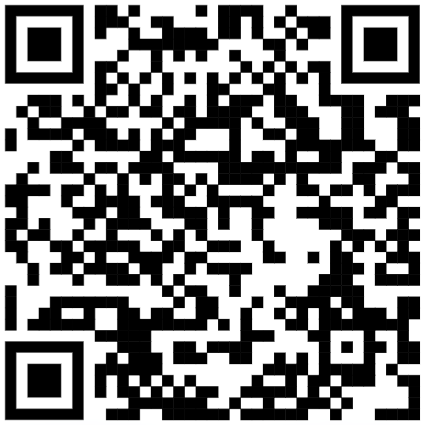


Gifted Education Fund AIoT Coding, Engineering and Entrepreneurial Skills Education for Gifted Students Mask Recognition on Public Transports
Student: 02 Ames Ng
Background/Motivation
Background / Motivation:
This project started back in the days where the COVID situation is tense and wearing a mask was required.
Could I make a face-mask detection system that has a higher usage by the public?
Answer: Integrating it with public transport!
Objective
Approving Octopus transaction when the system recognizes you wearing a mask correctly.
Existing Solution
As far as I have searched, there is not a single program which fits my requirements, i.e. integrating with electronic payment systems
Even though there are many mask recognition systems online, it can be easily fooled.
Your Solution
Train numeral Cascade Classifiers based on libraries found online, to recognize people’s facial features.
Detect whether the user has worn a mask correctly (without nose sticking out) and not covered by a hand (maybe cheating)
Will not be fooled by objects such as hands / phone
Multiple people can be detected at once
Resources Needed
Octopus / NFC Reader (Not used at last)
NFCs (Not used at last)
Phone / Board with camera installed
A green box will appear when you wore a mask correctly. On the other hand, a red box will appear around your face if you did not wear the mask / wore incorrectly.
Difficulties
I am using a Macbook air with M1 chip installed; many libraries hadn’t upgraded to support this new chip.
The Octopus system cannot be integrated as it is heavily guarded by the government.
Time is tight as I had to focus much time to my studies towards next year’s F.4 subject placement. As a result, I did not finish the last integration part.
QR Codes: (From Left to Right:)
Left: YouTube link, Pure testing
Middle: YouTube link, Project explained in detail
Right: Github Repository

